Slide 1
Team Building Workshop
Presented By : Najwa Mohammed

Slide 2
Table of Contents
01
02
03
04
Introduction
Effective
Communication
Interpersonal
Skills
Time
Management
Skills

Slide 3
01
Introduction

Slide 4
About Me
Hello, my name is Najwa. I am the Assistant of Training and Development Manager in Cognizant Pvt Ltd in Dubai, This event will span over two days and will be held in our company hall designated for workshops and training courses. This workshop focusing on the complexities of the dynamics of effective teamwork. We will train you during these two days to be able to communicate effectively, take responsibility, have strong skills in dealing with others, and manage time efficiently.

Slide 5
My Team
Ahmad
Nora
Alma
Ibrahim

Slide 6
Effective Communication
02

Slide 7

Effective Communication
It is a process of communication between two or more people, with the aim of conveying a specific message and understanding it correctly and successfully. The concept of effective communication goes beyond just exchanging information between people and conveying messages. Rather, effective communication includes understanding the feelings of others and understanding their underlying intentions.

Slide 8

Communication
Communication is the transmission of an idea or feeling so that the sender and receiver share the same understanding.
It can be sharing of ideas, concepts, feelings and emotions.

Slide 9
Types of Communication
Verbal Communication
Non Verbal Communication
Written Communication
Visual Communication

Slide 10
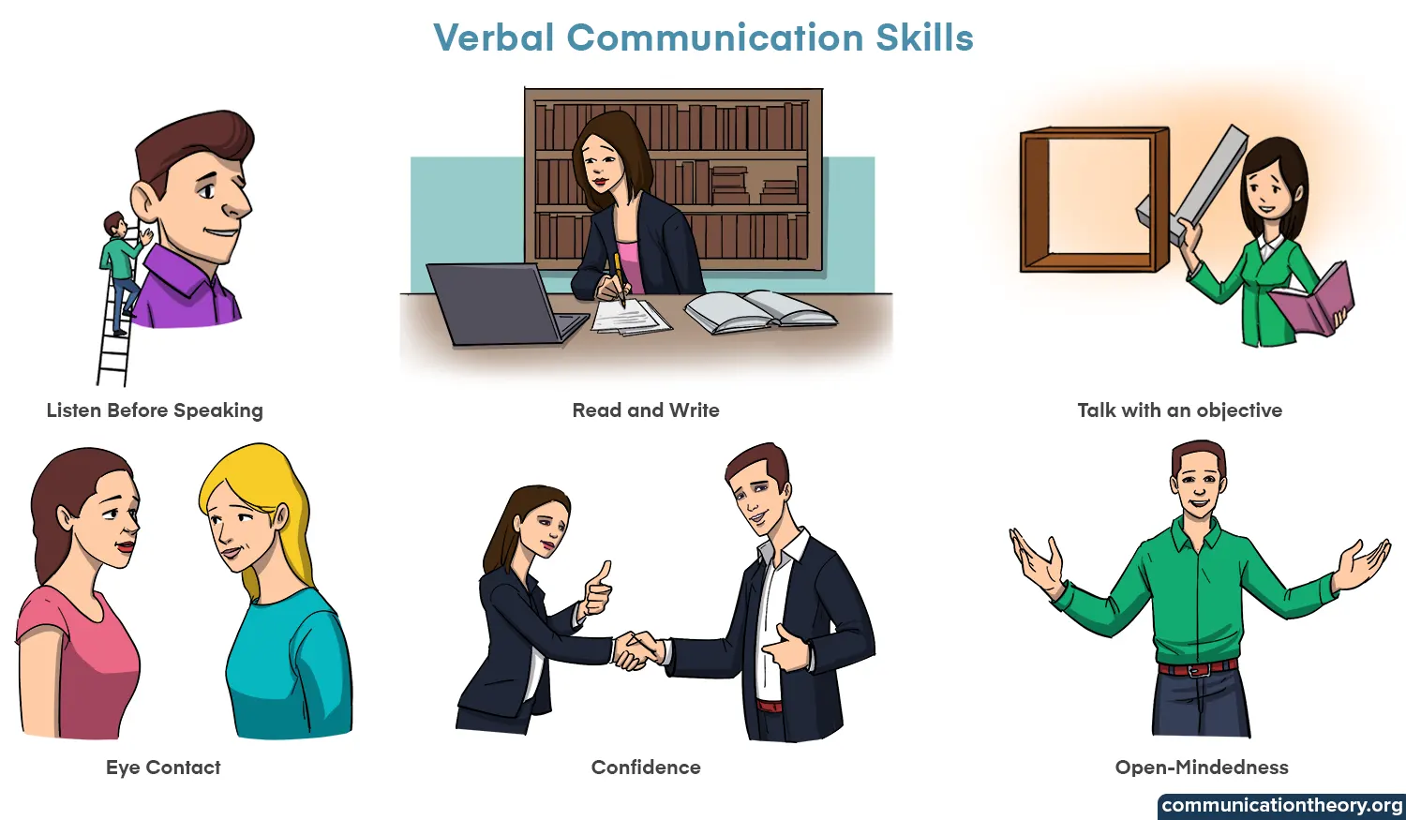
Verbal Communication
In verbal communication, we convey information and a message to the other person by using both written and spoken language. Put another way, verbal communication occurs whenever we use words to convey who we are, what we're experiencing, and what's on our minds.

Slide 11
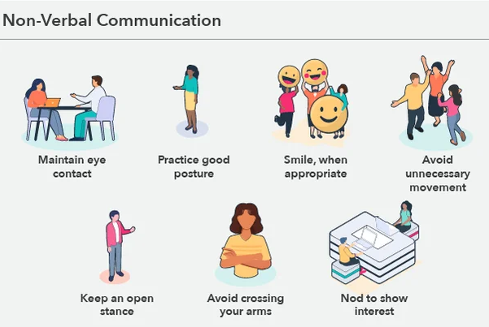
Non Verbal Communication
Nonverbal communication (NVC) is the exchange of information using nonverbal cues, such as gaze, posture, gestures, facial expressions, body language, use of objects, kinesics, distance (proxemics), appearance/physical environments, voice (paralanguage), touch (haptic), and social cues.

Slide 12
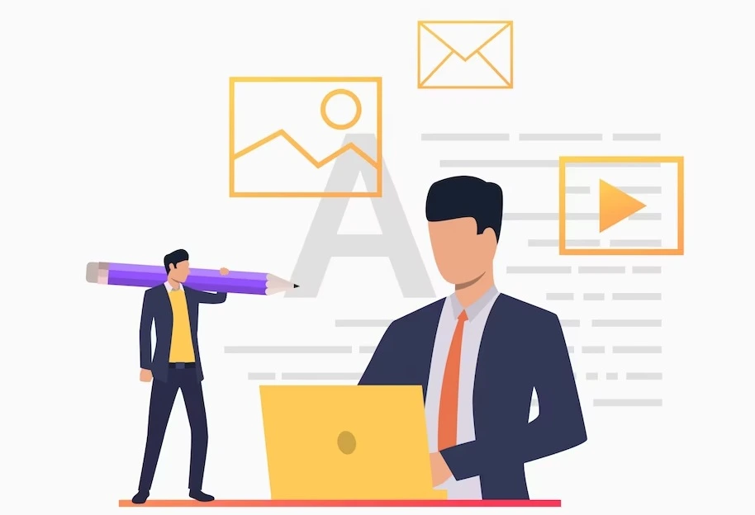
Written Communication
Any written message exchanged by two or more individuals is referred to as written communication. Compared to spoken communication, written communication is usually less efficient but more formal. Emails are one type of written communication.

Slide 13

Visual Communication
The use of visual components, such as signs, typography, drawings, graphic design, illustrations, industrial design, advertising, animation, and electronic resources, to communicate ideas and information is known as visual communication.

Slide 14



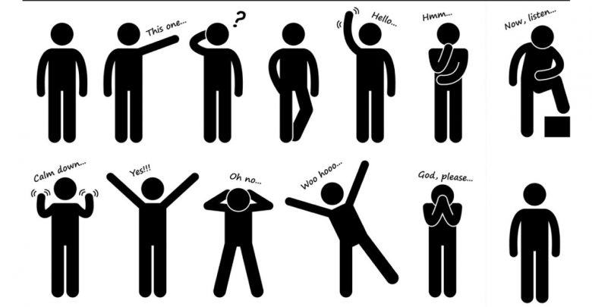
The most common ways we communicate
Spoken
Word
Visual
Images
Written
Word
Body
Language

Slide 15

Formal and Informal Dialogue
Formal and informal dialogue represent two distinct styles of communication, each tailored to specific social contexts, relationships, and settings. These styles dictate the tone, language, and structure of conversations, influencing how individuals interact with one another.
In summary, formal and informal dialogue serve different purposes and are adapted to the specific social and professional contexts in which they occur. Mastering both styles of communication is essential for effective interpersonal relationships and navigating diverse social environments.

Slide 16
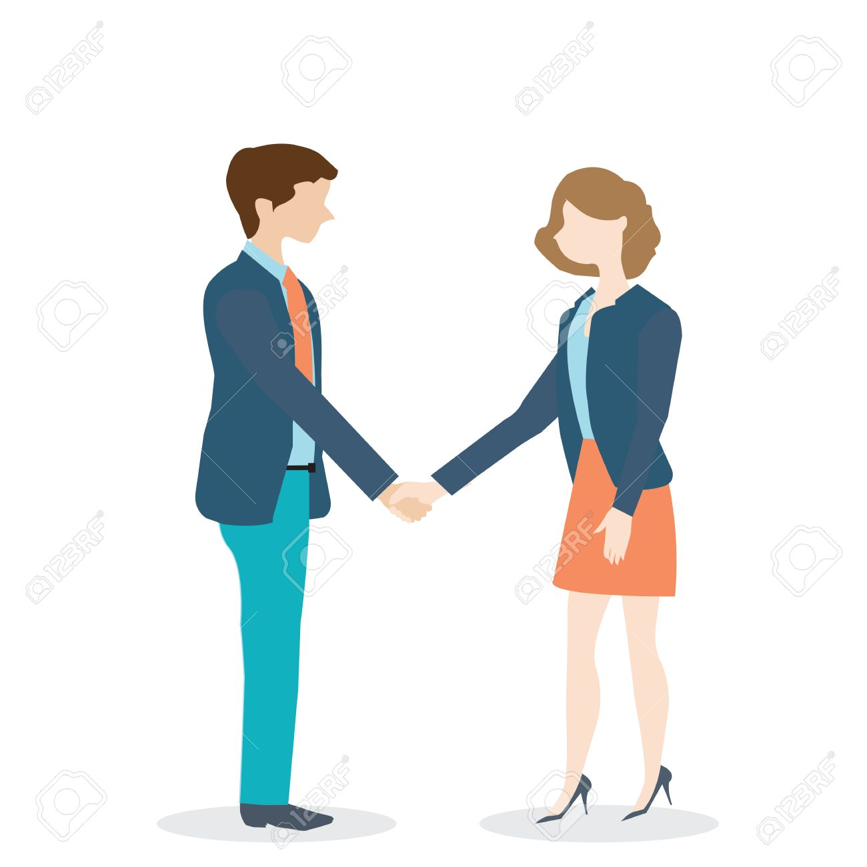
Formal Dialogue
Formal Dialogue:
Formal dialogue is characterized by a more structured and polished communication style. It is often used in professional settings, academic environments, official documents, or any situation where a high level of decorum and respect is expected.

Slide 17
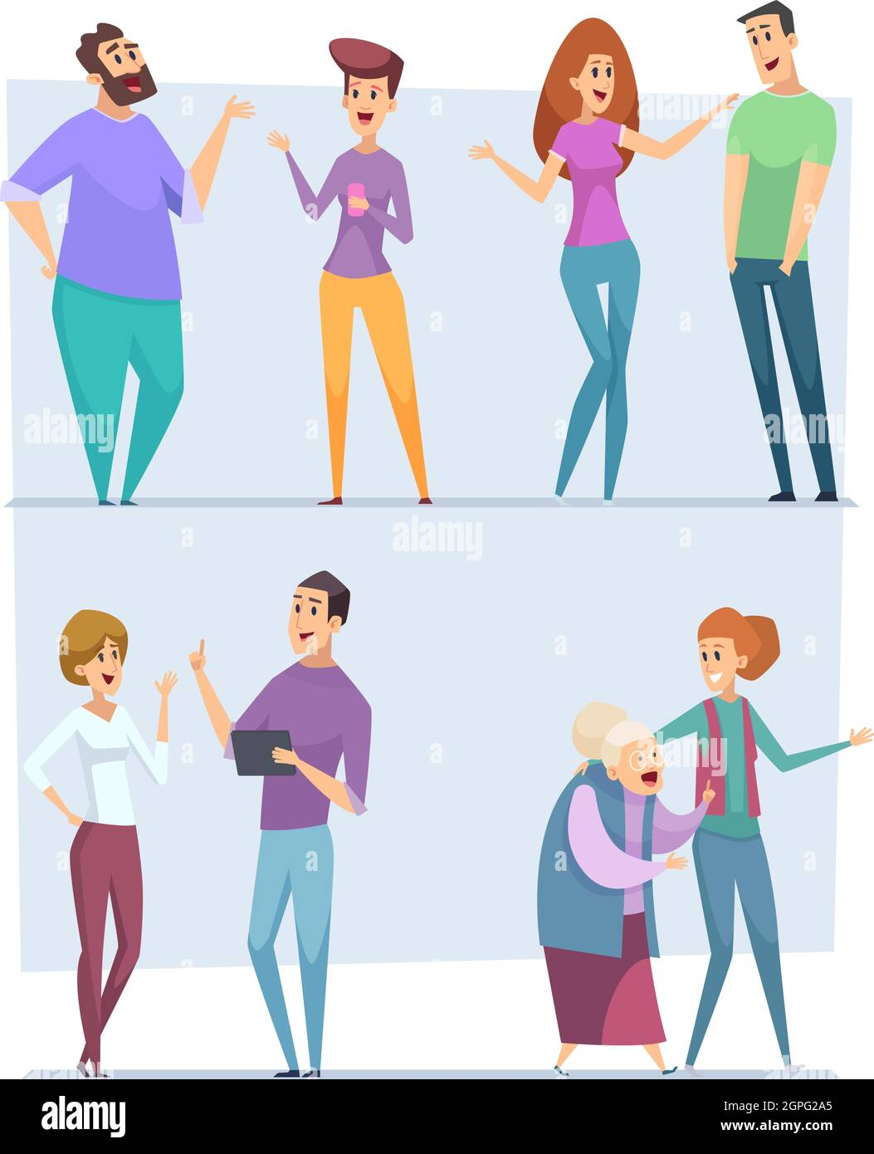
Informal Dialogue
Informal Dialogue:
Informal dialogue, on the other hand, is characterized by a more relaxed and casual style. It is commonly used in everyday conversations among friends, family, and acquaintances.

Slide 18
—Phil Jackson.
“The strength of the team is each individual member. The strength of each member is the team.”

Slide 19
Activity to Break the Ice Two Truths and a Lie Group size: 5-8 people per group
Purpose of activity: to build familiarity between colleagues
Time commitment: 30 minutes
To begin, one person must make three statements about themselves to the rest of the group. The trick is that not all statements will be true - two of the statements given should be; and one should be a lie. Once you are done, everyone should guess which statement they think you made up.

Slide 20
Discuss with Trainees
What have you learned about effective communication?
What do you think about effective communication?
What is its importance?
What do you expect to happen if there is effective communication between employees?
How far will this company achieve in terms of achievements?

Slide 21
Thanks!
Good bye
We will continue our workshop tomorrow
See you at the same time

Slide 22
Hi Every One Welcome Bake In Team Building Workshop

Slide 23
Brief Overview Of the Previous Day's Key Points

Slide 24
03
Interpersonal Skills

Slide 25
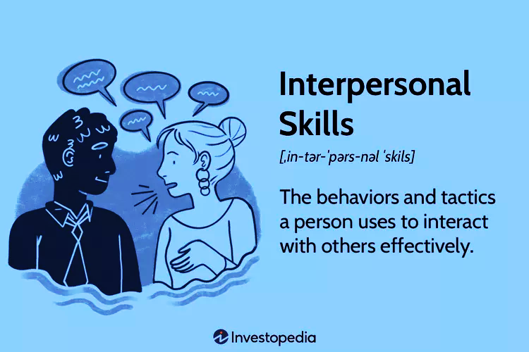
What are Interpersonal Skills?
Interpersonal skills are the behaviors and tactics a person uses to interact with others effectively. People use interpersonal skills all the time when dealing with others, whether in the workplace, in social situations, or within a family.
In the business world, the term generally refers to an employee's ability to work well with others. Interpersonal skills range from ways of communicating and listening to attitude and deportment.

Slide 26
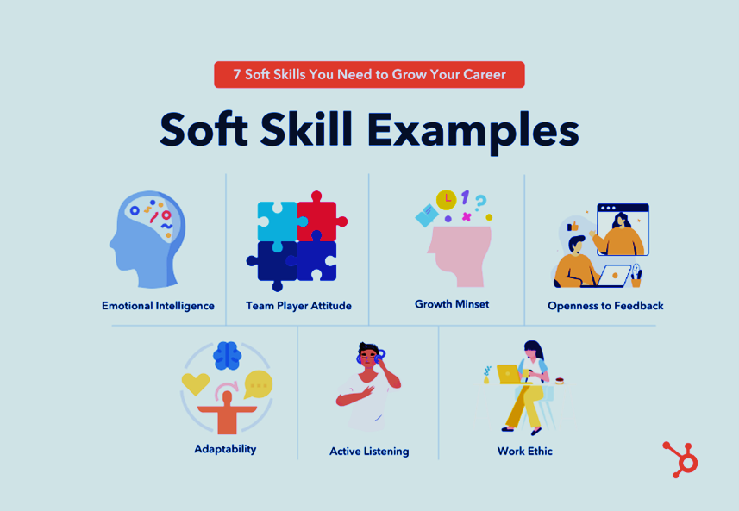
SOFT SKILL
Too many different soft skills exist to focus on just a few. It is the capacity needed and expected of people in order to get, hold, and advance in an appropriate profession. Examples of this capacity include:
Personal effectiveness
Working with others
Use of initiative
Negotiating skills
Assertiveness skills
social Skills
Ensure that people can cooperate well at work with the least amount of conflict.

Slide 27

Personal Effectiveness
Personal effectiveness
Using all of your own resources—talents, abilities, energy, and time—to help you reach your goals in life and at work is what it means to be personally effective.
Your personal effectiveness is significantly impacted by how you handle yourself.
The keys to enhancing your own performance are self-awareness, maximizing your talents, picking up new abilities and methods, and gaining behavioral flexibility.

Slide 28

Working with Others
Working with others
Teams are a part of everyone's life.
Teamwork is the idea of individuals working together as a group for a single goal under the same values. Since you're a part of the family team, it makes sense that you know how to contribute to the team successfully. Allowing team members to speak candidly with one another fosters an environment of trust and open, honest communication. It also encourages the sharing of feedback and helps team members resolve misunderstandings and problems.

Slide 29

Use of Initiative
Use of initiative
The ability to think and act independently, without being prodded or instructed, is known as initiative. It is the act of taking the initiative and completing tasks without waiting for instructions.
It is said by some that "needs are the mother of all inventions." Actually, the source of all inventions is initiative. Only Thomas Edison took the effort to address the need for light bulbs, despite the fact that millions of people needed them.

Slide 30

Negotiating Skills
Negotiating skills
The next crucial interpersonal skill for successful corporate communication is negotiation, which refers to the talent of professionally discussing and coming to a decision.

Slide 31
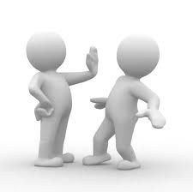
Assertiveness Skills
Assertiveness skills
Being assertive is about being confident in yourself, which entails having a good outlook on both yourself and other people.
Being confident in yourself;
Having self-assuredness.
Maintaining your focus.
Being loyal to yourself.
Developing self-worth.
Caring for yourself.
Respecting your rights and those of others

Slide 32

Social Skills
Social skills
A person's ability to engage and communicate with others through body language, gestures, and appearance is known as their social skills.
Since we are social creatures, humans have evolved a variety of means to express our ideas, feelings, and messages to other people.
Possessing strong social skills has the following benefits:
more and better connections.
improved communication.
increased efficiency.
improved employment possibilities.
increased enjoyment overall.

Slide 33
—Reid Hoffman.
“No matter how brilliant your mind or strategy, if you’re playing a solo game, you’ll always lose out to a team”

Slide 34
Activity to Break the Ice The one-word Group size: 4-5 people per group
Purpose of activity: to understand feelings towards a work affair
Time commitment: 20 minutes
The one-word icebreaker game requires a group or groups made of 4-5 people. Within that group, each member is asked to give a one-word descriptor of a work event.
For honest conversation, each group has a few minutes to discuss the reasons behind their chosen word. After discussions, each group will settle on a chosen word to be shared with other groups.
When these words are shared, they will prompt open discussion between the groups.

Slide 35
04
Time Management Skills

Slide 36

A picture is worth a thousand words

Slide 37

Time Management
Time management is the art of arranging, organizing, scheduling and budgeting one’s time for the purpose of generating more effective work and productivity. And It is the act or process of exercising conscious control over the amount of time spent on specific activities, especially to increase efficiency or productivity. Time management may be aided by a range of skills, such as self-motivation, planning, decision making and etc.

Slide 38
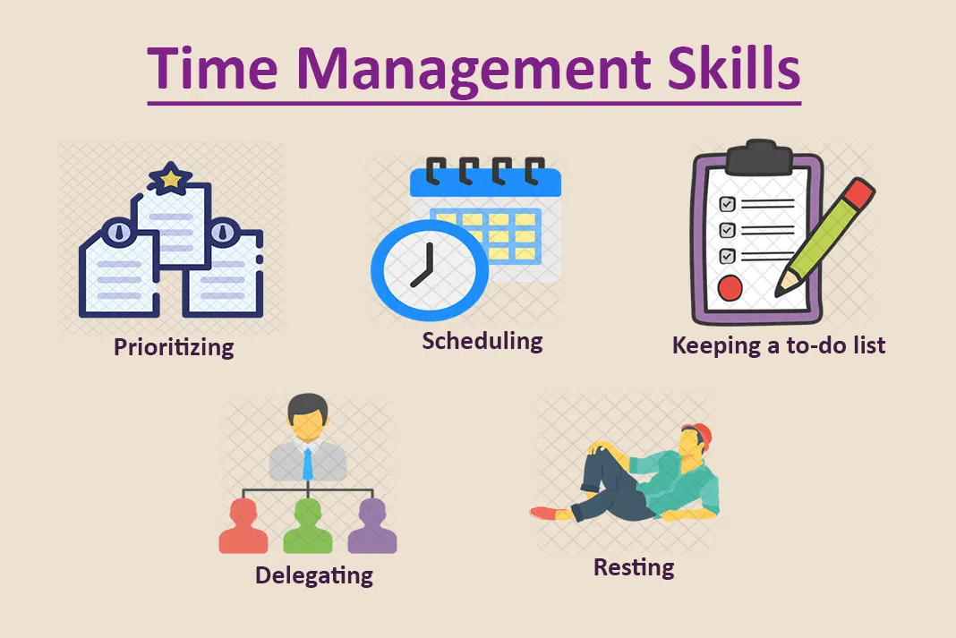
Time Management Skills
Prioritizing
Workloads
Setting
Objectives
Using Time
Effectively
Making and keeping
Appointments
Planning and Scheduling
Tasks and Activities

Slide 39
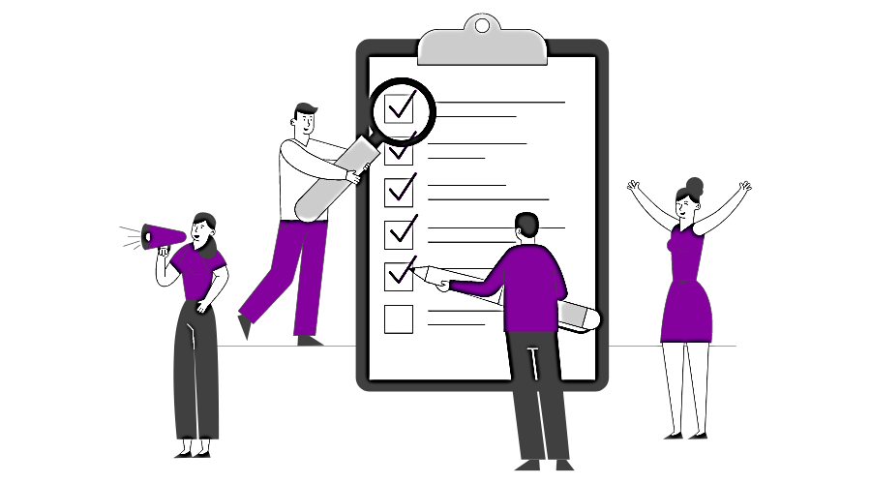
Prioritizing Workloads
Prioritizing workloads
Setting priorities for the tasks at hand is crucial.
Without it, no matter how hard you work on anything, it won't be strategically important, and you won't get the outcomes you want.
When determining your daily priorities, give careful thought to the things that must be finished immediately.
To determine how much time to spend on each task, one should go over all of the ones they need to finish.

Slide 40

Setting Objectives
Setting objectives
You must establish goals in order to begin time management properly.
Knowing your destination can help you determine the precise tasks that need to be completed and in what order.
You will waste time focusing on competing priorities if you don't set clear goals.
Because goal planning takes time and effort, people often overlook it. However, they overlook the fact that a small amount of time and effort today can save a large amount of time, effort, and aggravation later on.

Slide 41

Using Time Effectively
Using time effectively
Making good use of time, not merely efficient use of it. A significant activity has a result that helps you reach your objectives. Activities that are urgent require quick attention and are frequently connected to the accomplishment of other people's objectives. We frequently focus on the tasks that are urgent.

Slide 42

Making and Keeping Appointments
Making and keeping appointments
A person will always know what work needs to be done and when if they write down and keep track of project deadlines.
Reviewing all parts of a job assignment before beginning is a sensible move. Having a general idea of the project will let the person decide how much time to dedicate to it.
In order to allow for last-minute adjustments, one should make an effort to complete a job ahead of schedule.
Preparing a timeline for task completion is crucial in order to achieve project deadlines.
Meeting project deadlines is a sign of professionalism to supervisors, clients, and colleagues.

Slide 43

Planning and Scheduling Tasks and Activities
Planning, scheduling tasks and activities
Establishing a daily routine can aid in maintaining organization in the face of a high workload. It also helps to balance the amount of time allocated to each activity or project at work.
A daily timetable in writing can assist someone in concentrating their energy on one job at a time.
Occasionally, a daily schedule needs to be modified to accommodate unforeseen events or tasks that require more time than anticipated.

Slide 44
Activity to Break the Ice A penny for your thoughts Group size: 5-7 people per group
Purpose of activity: to build personal relationships between workers
Time commitment: 30 minutes
This game provides an interesting spin on icebreakers. It requires pennies or coins with listed years and a container to place them in.
With the coins in the container, members of the group will reach in, and identify the year inscribed. The colleague will then share a personal event from that time.

Slide 45
“Individual commitment to a group effort — that’s what makes a team work, a company work, a society work, a civilization work.”
—Vince Lombardi

Slide 46
Discuss with Trainees
Based on your own opinion, discuss the following:
Identify and provide examples of effective time management activities.
Discuss the importance of setting objectives and explore short, medium and long term objective setting.
What have you learned from this workshop?
What is its importance?
How far will this company achieve in terms of achievements?

Slide 47
Thanks!
Do you have any questions?
najwamohammed1510@gmail.com

